Slide 1
Correlation and regression
MCB 288
Lecture 2
24 January 2022
Spring 2022

Slide 2
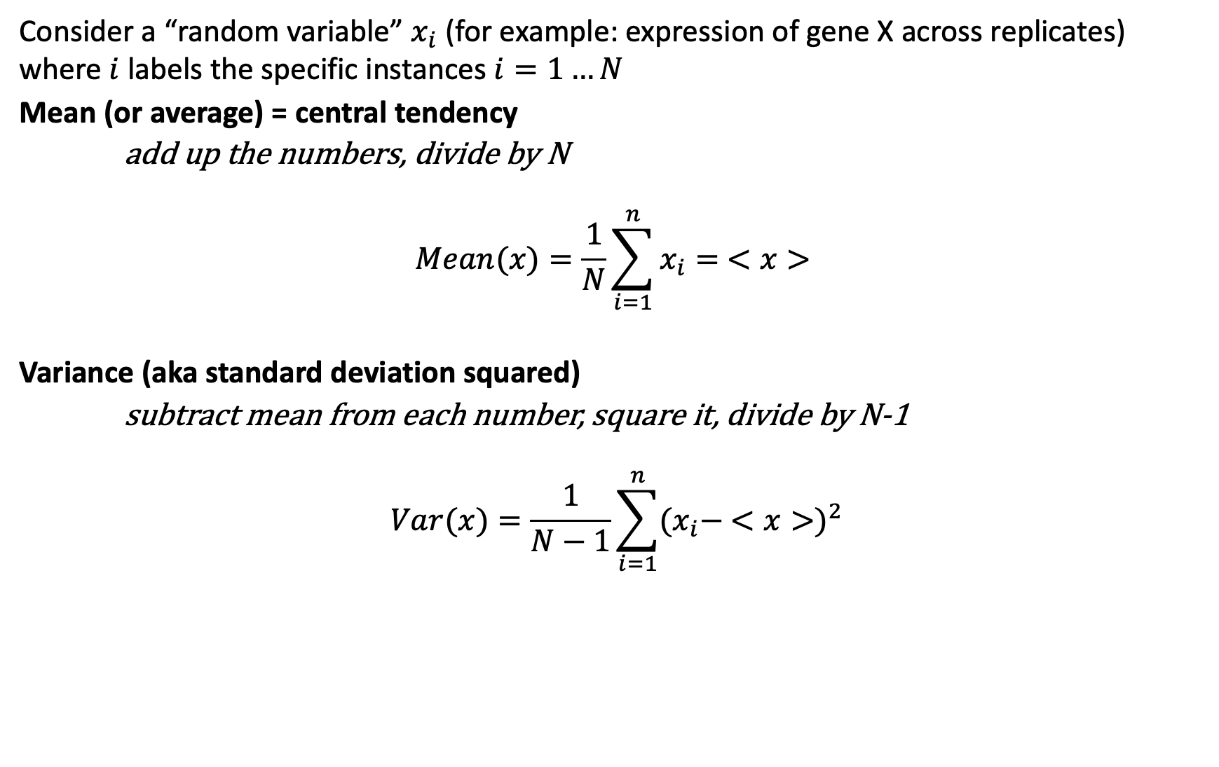
Why we prefer variance to standard deviation
Consider a “random variable” $x_{i}$ (for example: expression of gene X across replicates) where $i$ labels the specific instances $i=1…N$
Mean (or average) = central tendency
add up the numbers, divide by N
$$Mean(x)=\frac{1}{N}\sum_{i=1}^{n}{x_{i}= <x>}$$
Variance (aka standard deviation squared)
subtract mean from each number, square it, divide by N-1
$$Var(x)=\frac{1}{N−1}\sum_{i=1}^{n}{{(x_{i}− <x>)}^{2}}$$

Slide 3
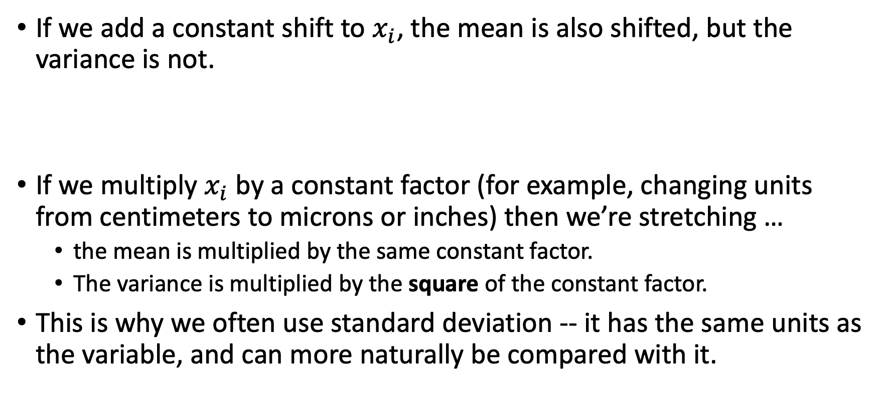
Trivial (but important) points
If we add a constant shift to $x_{i}$, the mean is also shifted, but the variance is not.
If we multiply $x_{i}$ by a constant factor (for example, changing units from centimeters to microns or inches) then we’re stretching …
the mean is multiplied by the same constant factor.
The variance is multiplied by the square of the constant factor.
This is why we often use standard deviation -- it has the same units as the variable, and can more naturally be compared with it.

Slide 4
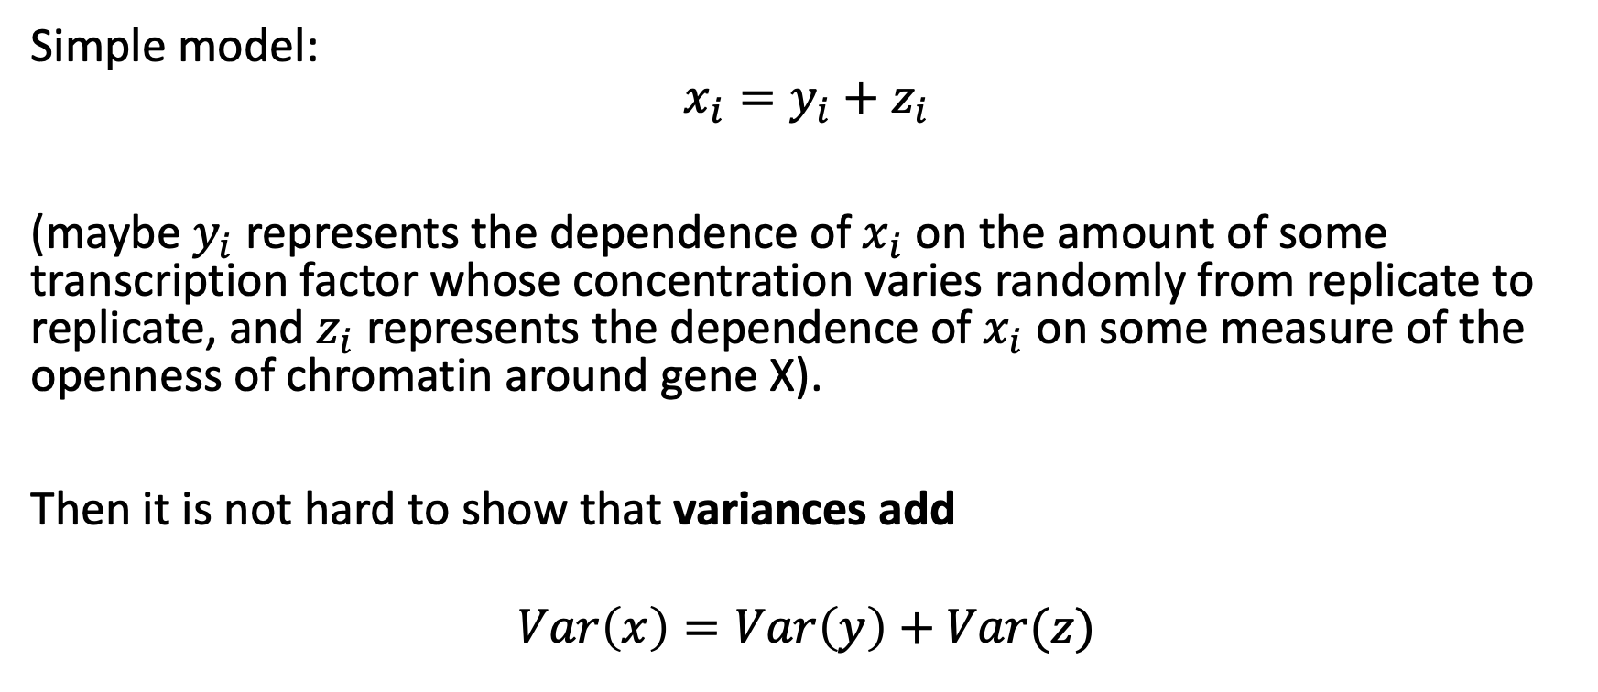
Often a random variable is (or can be thought of) as the sum of multiple underlying random factors
Simple model:
$$x_{i}=y_{i}+z_{i}$$
(maybe $y_{i}$ represents the dependence of $x_{i}$ on the amount of some transcription factor whose concentration varies randomly from replicate to replicate, and $z_{i}$ represents the dependence of $x_{i}$ on some measure of the openness of chromatin around gene X).
Then it is not hard to show that variances add
$$Var\left(x\right)=Var\left(y\right)+Var(z)$$

Slide 5
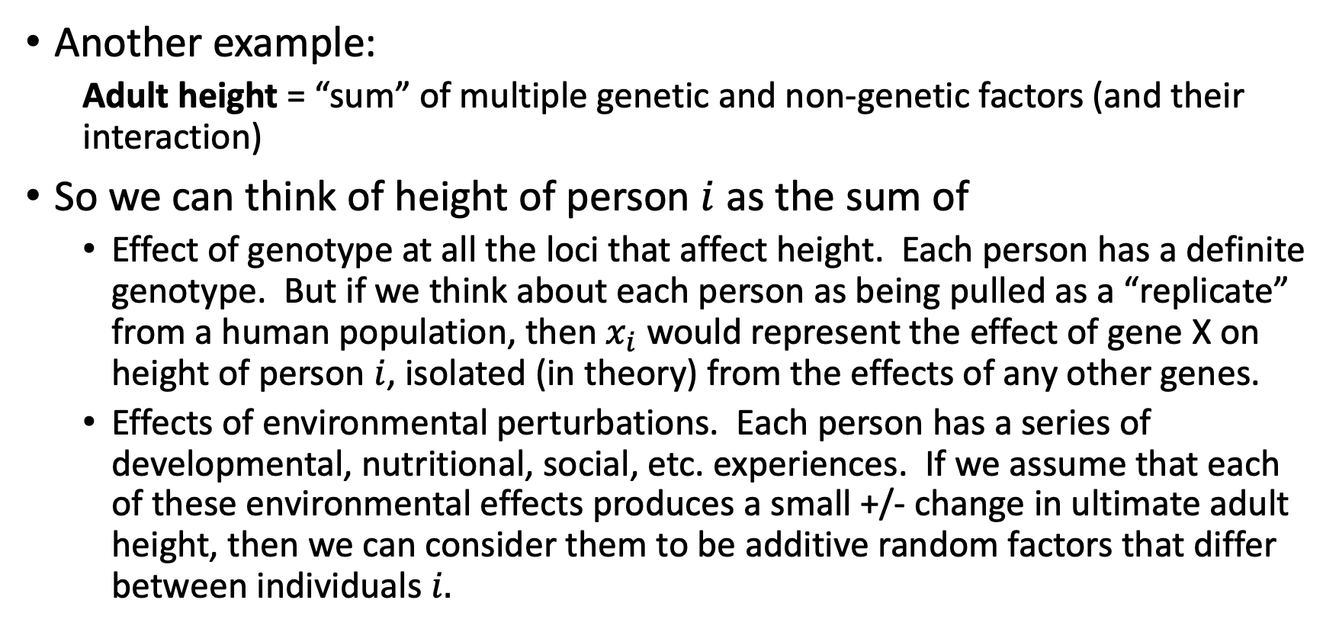
This has broad applicability
Another example:
Adult height = “sum” of multiple genetic and non-genetic factors (and their interaction)
So we can think of height of person $i$ as the sum of
Effect of genotype at all the loci that affect height. Each person has a definite genotype. But if we think about each person as being pulled as a “replicate” from a human population, then $x_{i}$ would represent the effect of gene X on height of person $i$, isolated (in theory) from the effects of any other genes.
Effects of environmental perturbations. Each person has a series of developmental, nutritional, social, etc. experiences. If we assume that each of these environmental effects produces a small +/- change in ultimate adult height, then we can consider them to be additive random factors that differ between individuals $i.$

Slide 6
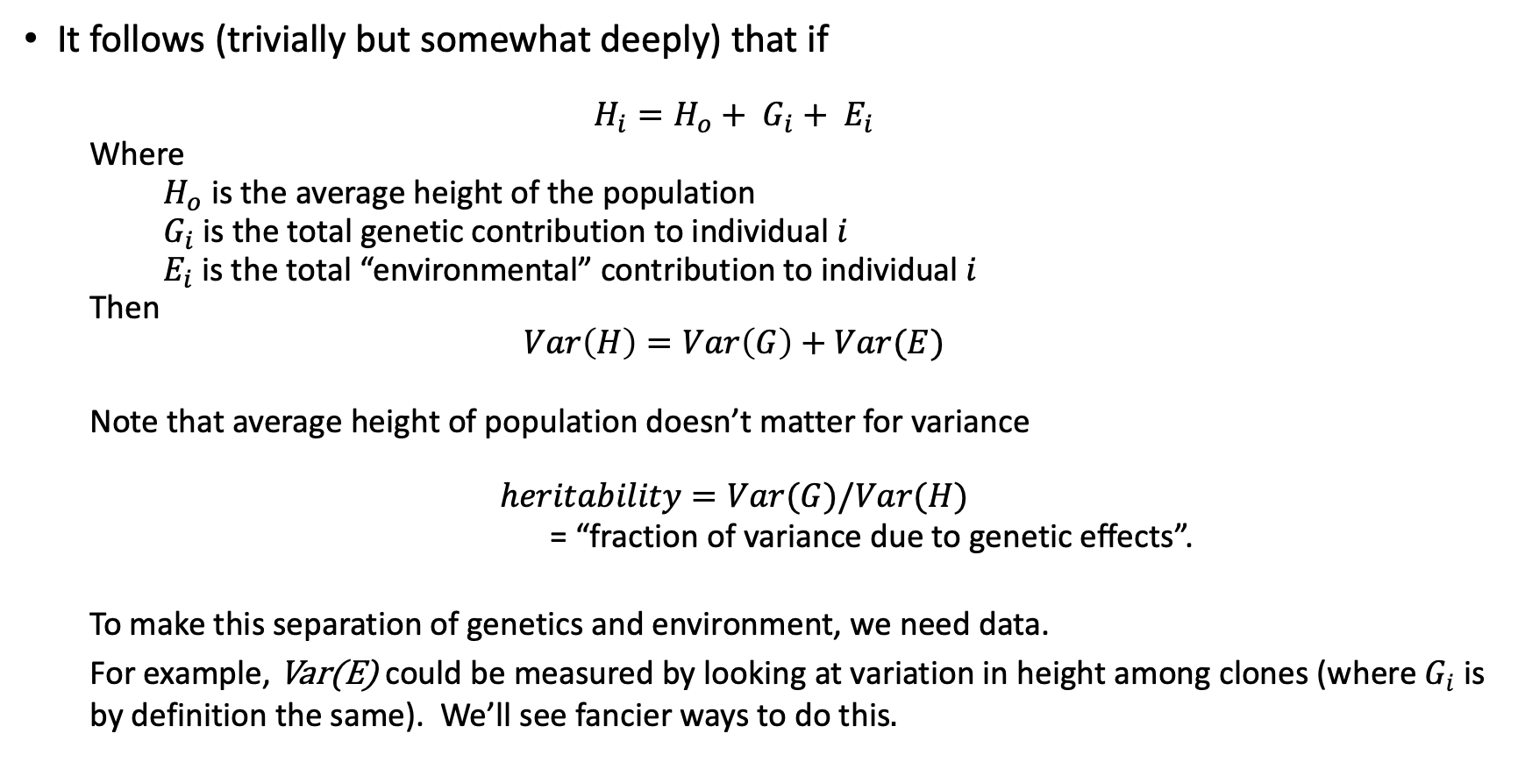
Partitioning variance
It follows (trivially but somewhat deeply) that if
$$H_{i}=H_{o}+ G_{i}+ E_{i}$$
Where
$H_{o}$ is the average height of the population
$G_{i}$ is the total genetic contribution to individual $i$
$E_{i}$ is the total “environmental” contribution to individual $i$
Then
$$Var\left(H\right)=Var\left(G\right)+Var(E)$$
Note that average height of population doesn’t matter for variance
$$heritability=Var(G)/Var(H)$$
= “fraction of variance due to genetic effects”.
To make this separation of genetics and environment, we need data.
For example, Var(E) could be measured by looking at variation in height among clones (where $G_{i}$ is by definition the same). We’ll see fancier ways to do this.

Slide 7
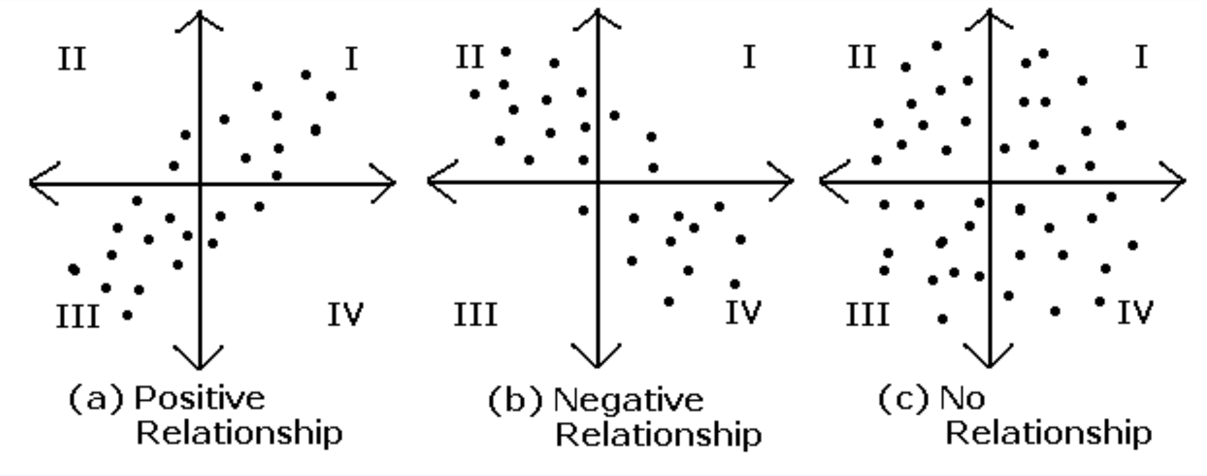
Comparing two variables: Correlation
multiplying (x-<x>) and (y-<y>) we get + when in I & III, - when in II & IV

Slide 8
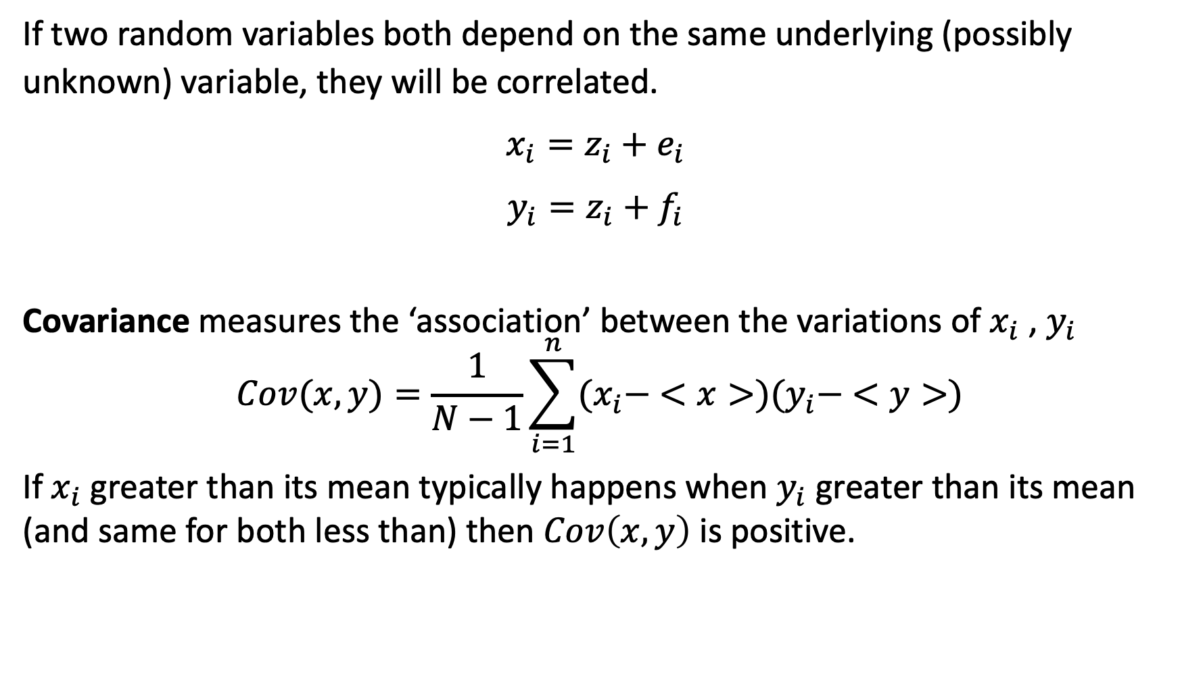
Covariance and correlation
If two random variables both depend on the same underlying (possibly unknown) variable, they will be correlated.
$x_{i}=z_{i}+e_{i}$
$y_{i}=z_{i}+f_{i}$
Covariance measures the ‘association’ between the variations of $x_{i}$ , $y_{i}$
$$Cov(x,y)=\frac{1}{N−1}\sum_{i=1}^{n}{(x_{i}− <x>)(y_{i}− <y>)}$$
If $x_{i}$ greater than its mean typically happens when $y_{i}$ greater than its mean (and same for both less than) then $Cov\left(x,y\right)$ is positive.

Slide 9
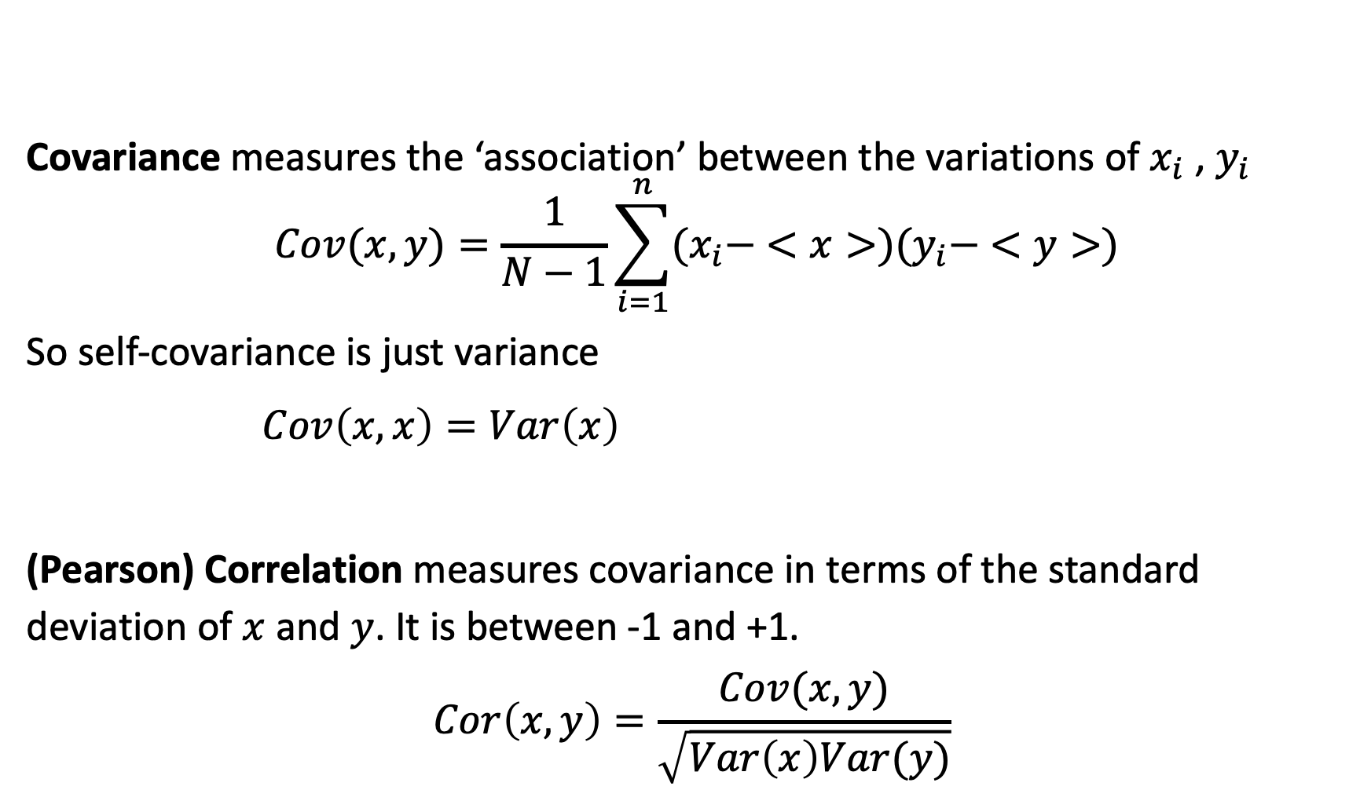
Covariance and correlation continued
Covariance measures the ‘association’ between the variations of $x_{i}$ , $y_{i}$
$$Cov(x,y)=\frac{1}{N−1}\sum_{i=1}^{n}{(x_{i}− <x>)(y_{i}− <y>)}$$
So self-covariance is just variance
$Cov\left(x,x\right)=Var\left(x\right)$
(Pearson) Correlation measures covariance in terms of the standard deviation of $x$and $y$. It is between -1 and +1.
$$Cor\left(x,y\right)=\frac{Cov(x,y)}{\sqrt{Var\left(x\right)Var(y)}}$$

Slide 10
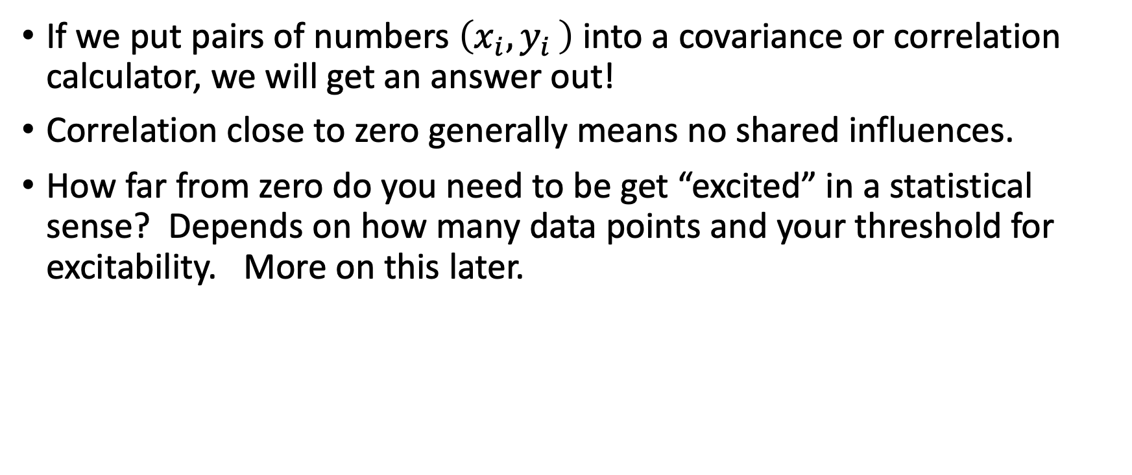
Significance
If we put pairs of numbers $\left(x_{i}{,y}_{i}\right)$ into a covariance or correlation calculator, we will get an answer out!
Correlation close to zero generally means no shared influences.
How far from zero do you need to be get “excited” in a statistical sense? Depends on how many data points and your threshold for excitability. More on this later.

Slide 11
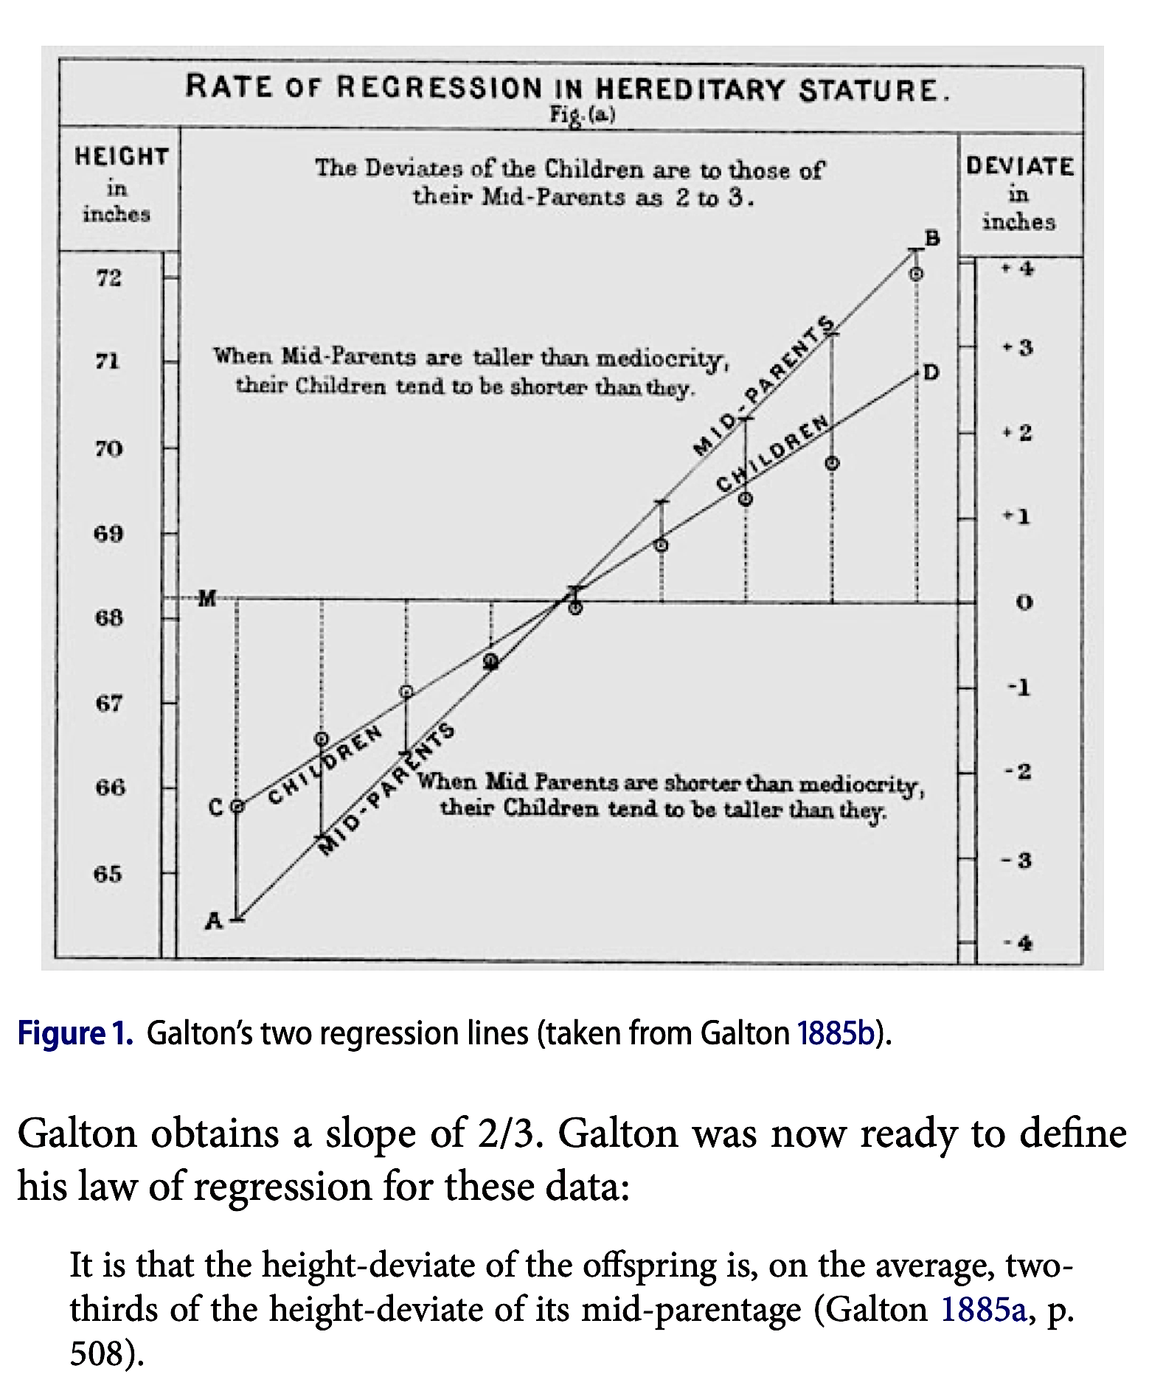
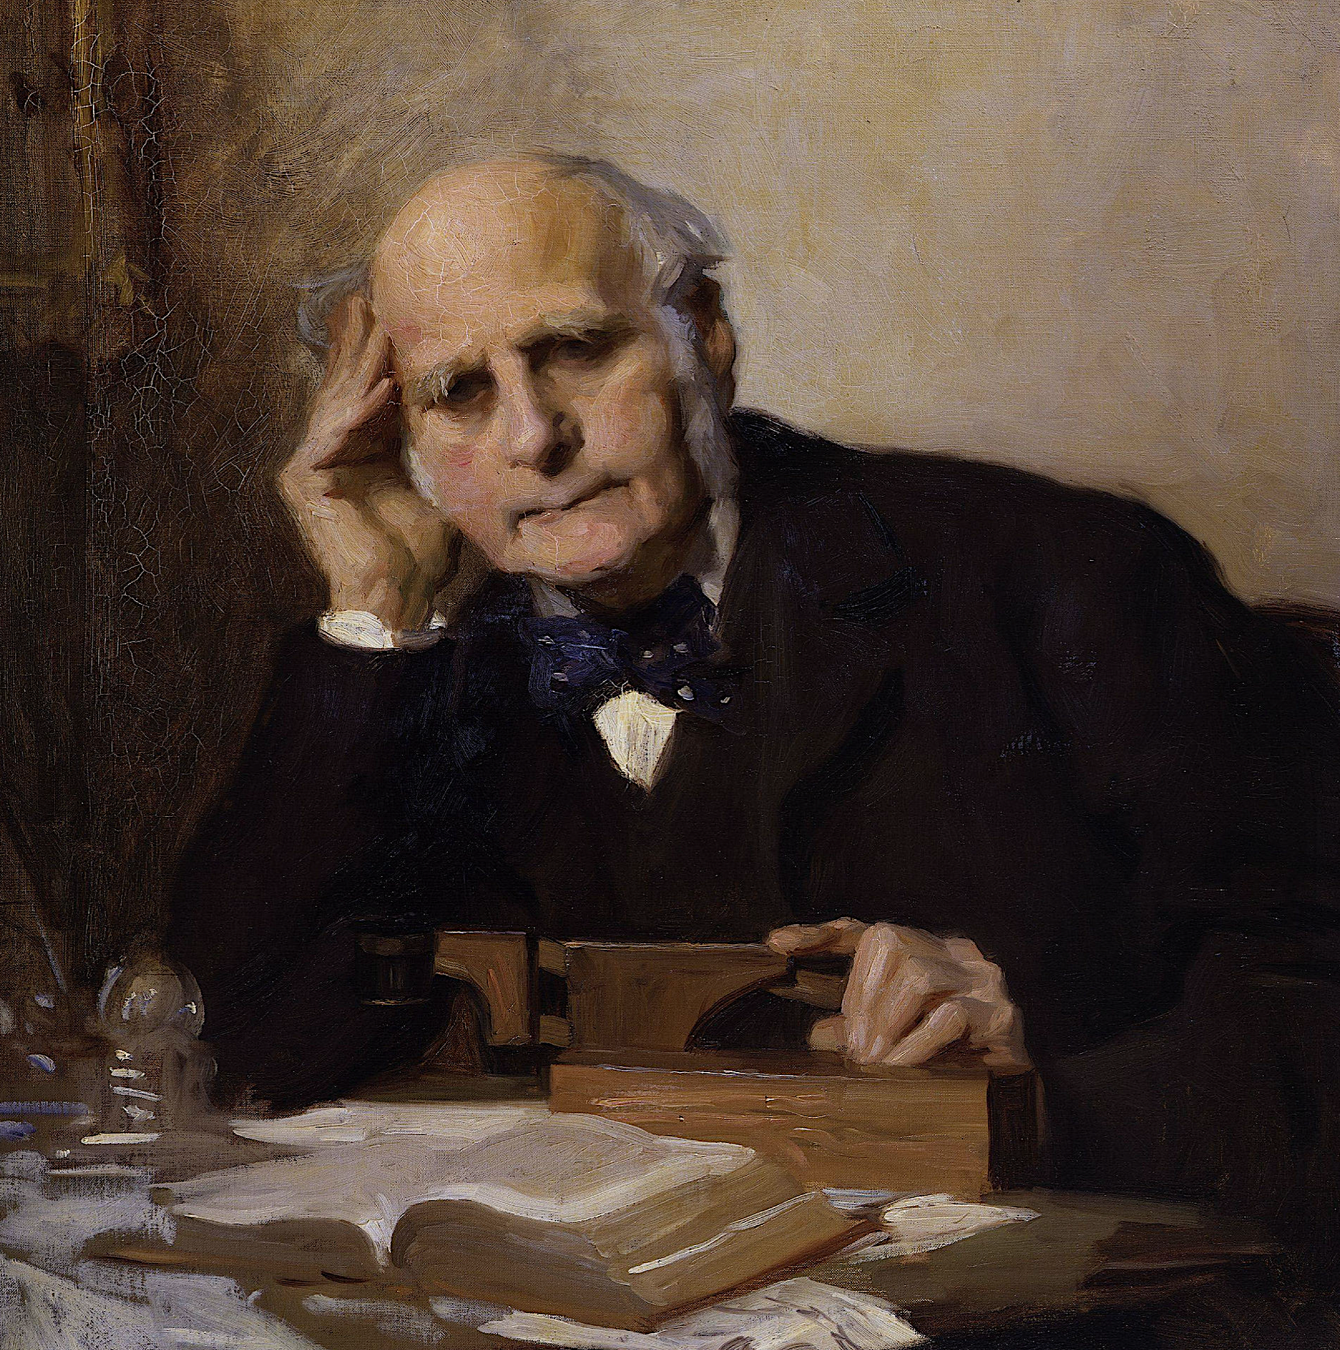
Linear regression
Gorroochurn (2016). “On Galton’s Change From “Reversion” to “Regression” The American Statistician

Slide 12
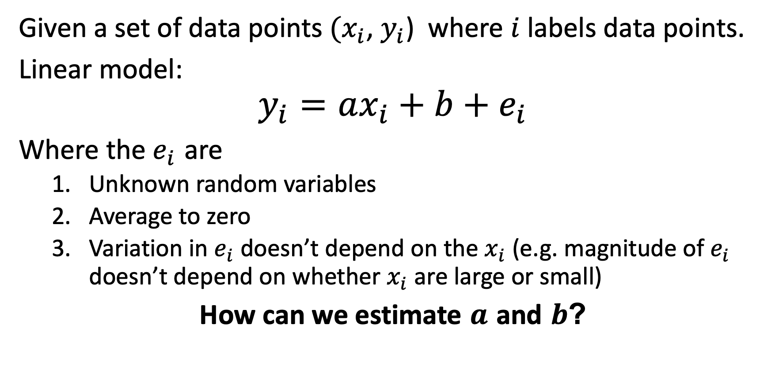
Linear “regression”
Given a set of data points $(x_{i}$, $y_{i}$) where $i$ labels data points.
Linear model:
$$y_{i}=ax_{i}+b+e_{i}$$
Where the $e_{i}$ are
Unknown random variables
Average to zero
Variation in $e_{i}$ doesn’t depend on the $x_{i}$ (e.g. magnitude of $e_{i}$ doesn’t depend on whether $x_{i}$ are large or small)
How can we estimate $a$ and $b$?

Slide 13
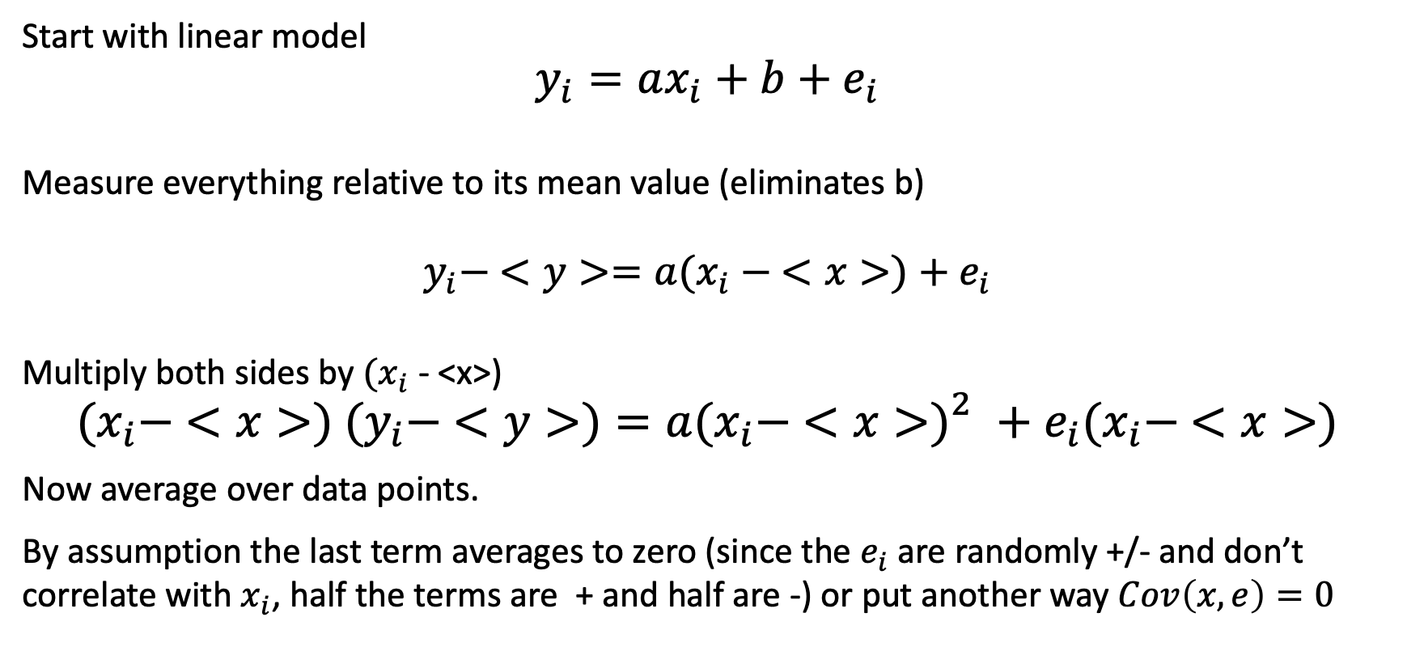
Linear “regression”
Start with linear model
$$y_{i}=ax_{i}+b+e_{i}$$
Measure everything relative to its mean value (eliminates b)
$$y_{i}− <y>=a{(x}_{i} − <x>)+e_{i}$$
Multiply both sides by ${(x}_{i}$ - <x>)
$${{(x}_{i}− <x>) (y}_{i}− <y>)=a{{(x}_{i}− <x>)}_{}^{2}+e_{i}{(x}_{i}− <x>)$$
Now average over data points.
By assumption the last term averages to zero (since the $e_{i}$ are randomly +/- and don’t correlate with $x_{i}$, half the terms are + and half are -) or put another way $Cov\left(x,e\right)=0$

Slide 14
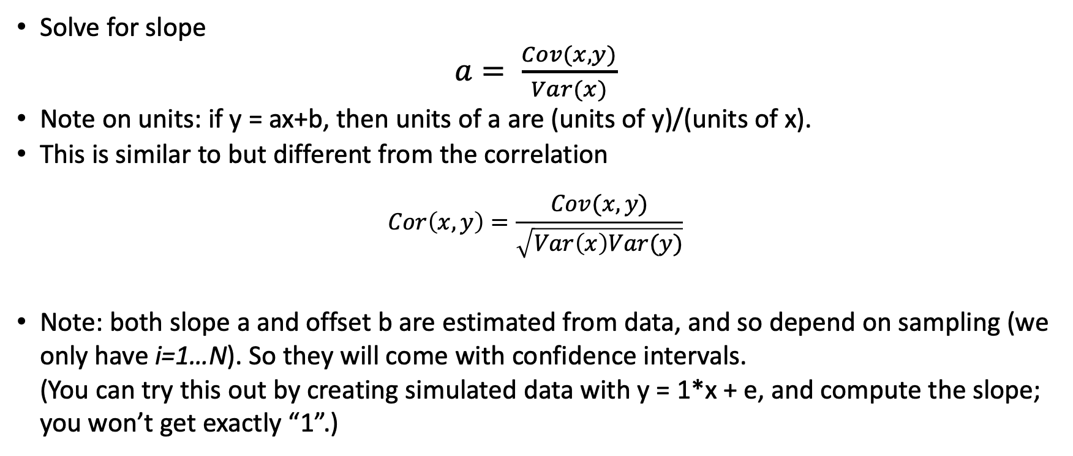
…
Solve for slope
$a= \frac{Cov(x,y)}{Var(x)}$
Note on units: if y = ax+b, then units of a are (units of y)/(units of x).
This is similar to but different from the correlation
$$Cor\left(x,y\right)=\frac{Cov(x,y)}{\sqrt{Var\left(x\right)Var(y)}}$$
Note: both slope a and offset b are estimated from data, and so depend on sampling (we only have i=1…N). So they will come with confidence intervals. (You can try this out by creating simulated data with y = 1*x + e, and compute the slope; you won’t get exactly “1”.)

Slide 15
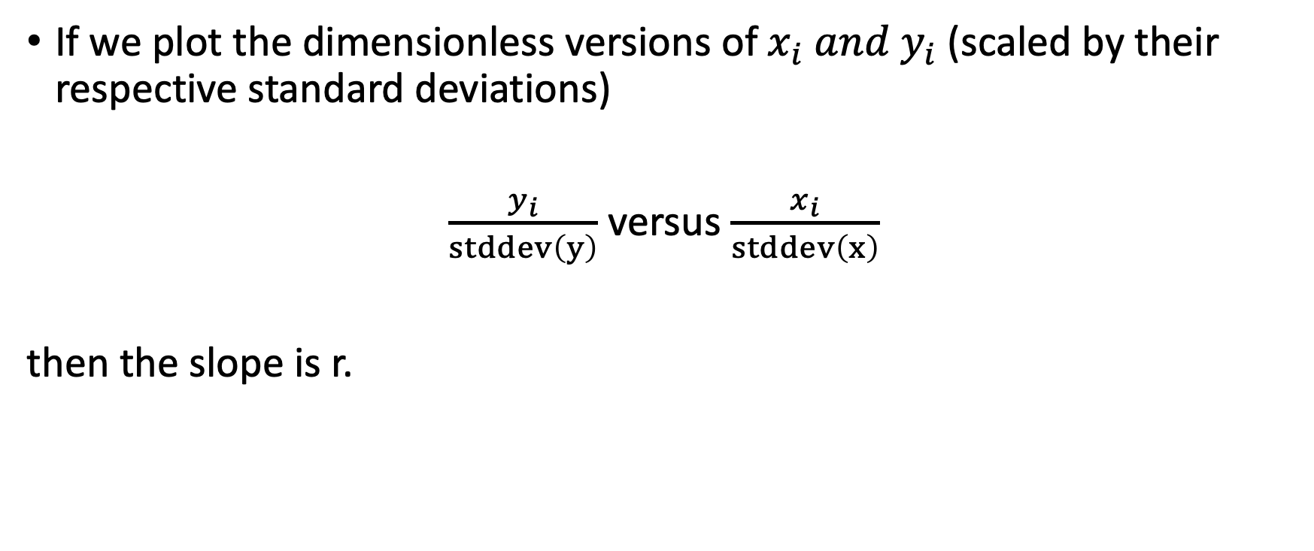
Put another way
If we plot the dimensionless versions of $x_{i} and y_{i}$(scaled by their respective standard deviations)
$\frac{y_{i}}{stddev\left(y\right)}$ versus $\frac{x_{i}}{stddev\left(x\right)}$
then the slope is r.

Slide 16
Correlation and linear regression both depend on Cov(x,y)
Cor(x,y) is dimensionless (between -1 and 1)
Slope of regression line obviously depends on scale on which x and y are measured

Slide 17
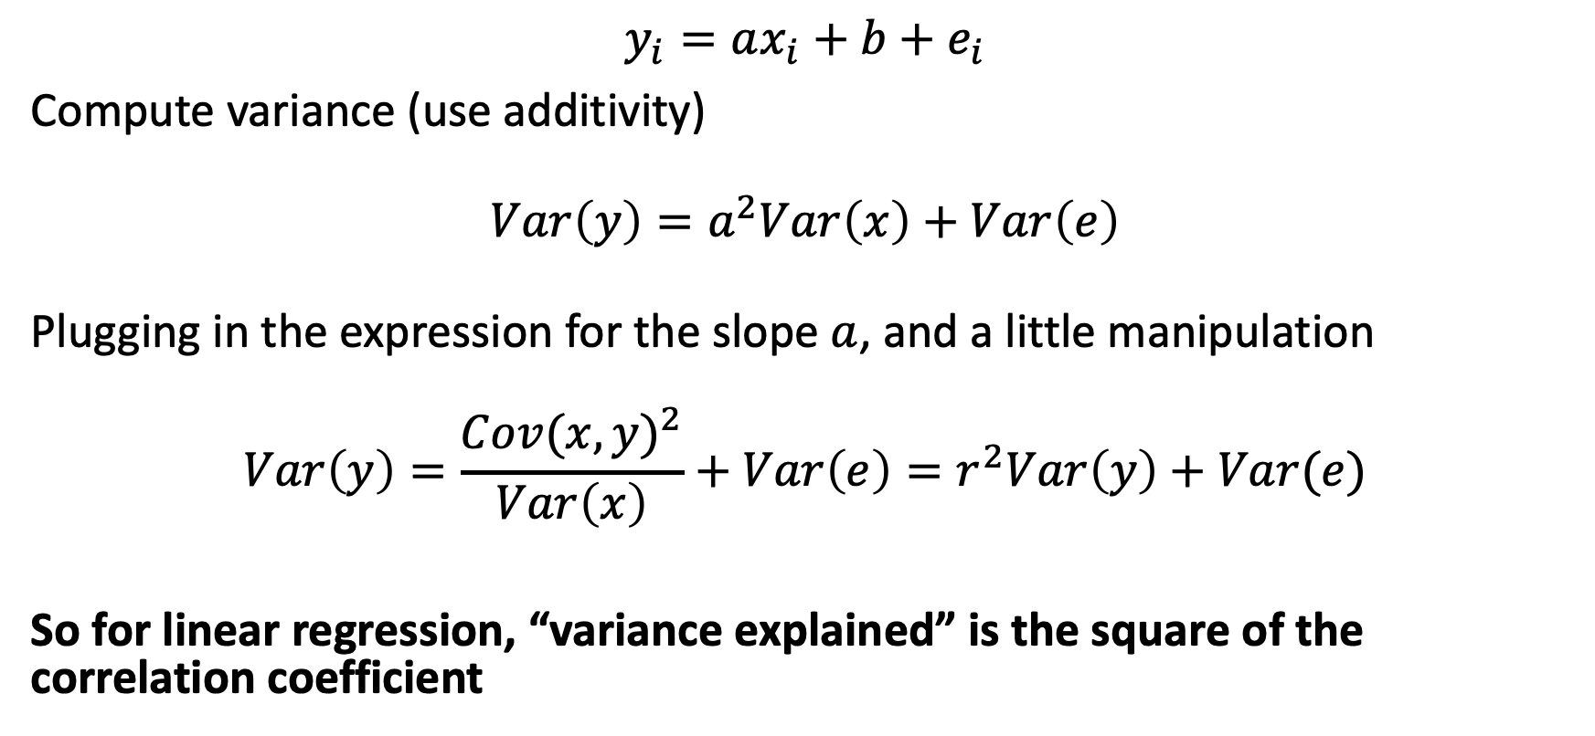
If y = ax+b, how much of the variance in y is “explained” by x?
$$y_{i}=ax_{i}+b+e_{i}$$
Compute variance (use additivity)
$$Var\left(y\right)=a^{2}Var\left(x\right)+Var\left(e\right)$$
Plugging in the expression for the slope $a$, and a little manipulation
$$Var\left(y\right)=\frac{{Cov(x,y)}^{2}}{Var\left(x\right)}+Var\left(e\right)=r^{2}Var\left(y\right)+Var(e)$$
So for linear regression, “variance explained” is the square of the correlation coefficient

Slide 18
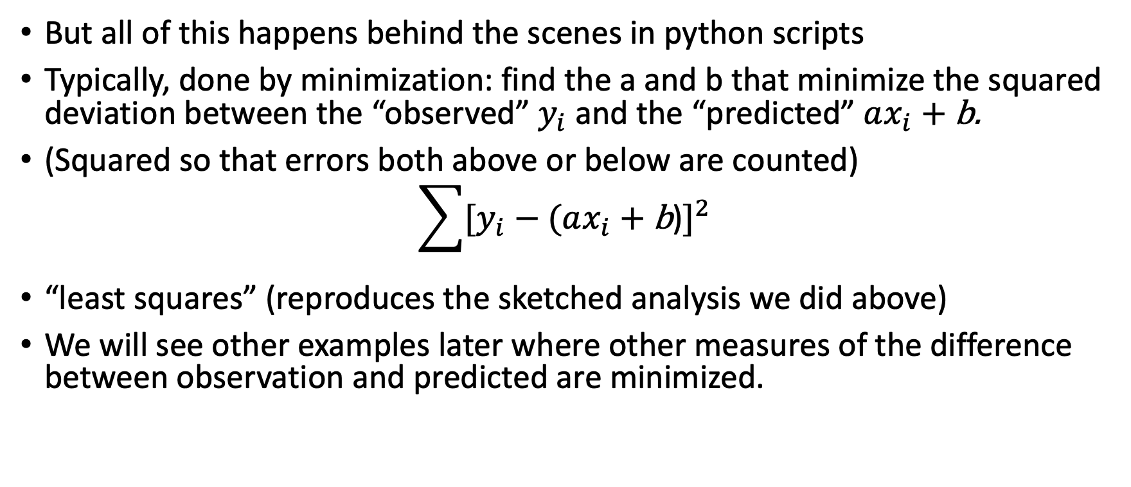
All of this is background so you know at least roughly what is going on “under the hood”
But all of this happens behind the scenes in python scripts
Typically, done by minimization: find the a and b that minimize the squared deviation between the “observed” $y_{i}$ and the “predicted” $ax_{i} \text{+} \text{b}$.
(Squared so that errors both above or below are counted)
$$\sum{{[y_{i}−(ax_{i} \text{+} \text{b}\text{)}]}^{2}}$$
“least squares” (reproduces the sketched analysis we did above)
We will see other examples later where other measures of the difference between observation and predicted are minimized.

Slide 19
Addendum: what if the observed effect is due to the multiplication of many small factors?
Data = (some constant)*(1+x₁)*(1+x₂)*(1+x₃)….(1+x_{n})
Where the x_{i} account for small influences and are equally likely to be + or –
Then log(data) = log(const) + log(1+x₁) + log(1+x₂) + log(1+x₃) + … + log(1+x_{n})
~ x₁ + x₂ + x₃ + … + x_{n}
So log(data) is normally distributed.
This is called (somewhat confusingly) the “log normal” distribution
Prescription: take logs and proceed as usual

